Slide 1
LGBoosting Regressor
- P.Hameed Femina

Slide 2
Outline
Introduction
Functionality
Algorithm

Slide 3
What is LGboosting Regressor
LightGBM is a gradient boosting ensemble method that is used by the Train Using AutoML tool and is based on decision trees. As with other decision tree-based methods, LightGBM can be used for both classification and regression. LightGBM is optimized for high performance with distributed systems.

Slide 4
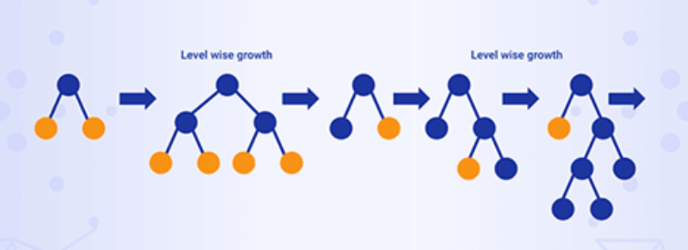

Slide 5
Advantage and Disadvantage
Advantage:
With large data set data more that 10000 it will work good
Disavantage:
1. With small data set overfitting issue will come

Slide 6
Algorithm - syntax
Pip install lightgbm
Import lightgbm as ltb
Model =ltb.LGBMRegressor()

Slide 7
Thankyou

